Slide 1
Examples of real-world networks

Slide 2
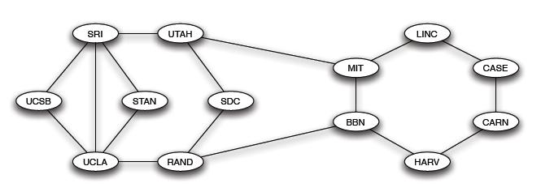
What Is a Network?
vertex (node)
edge (link, tie)

Slide 3
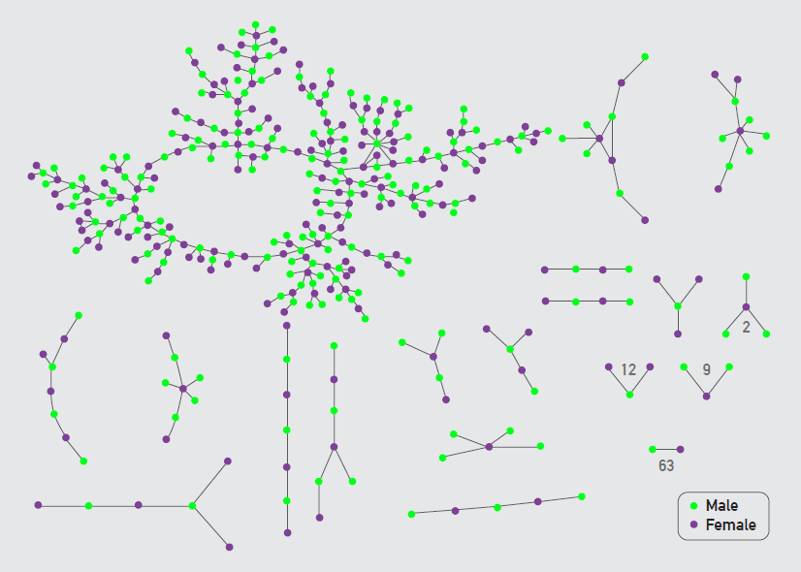
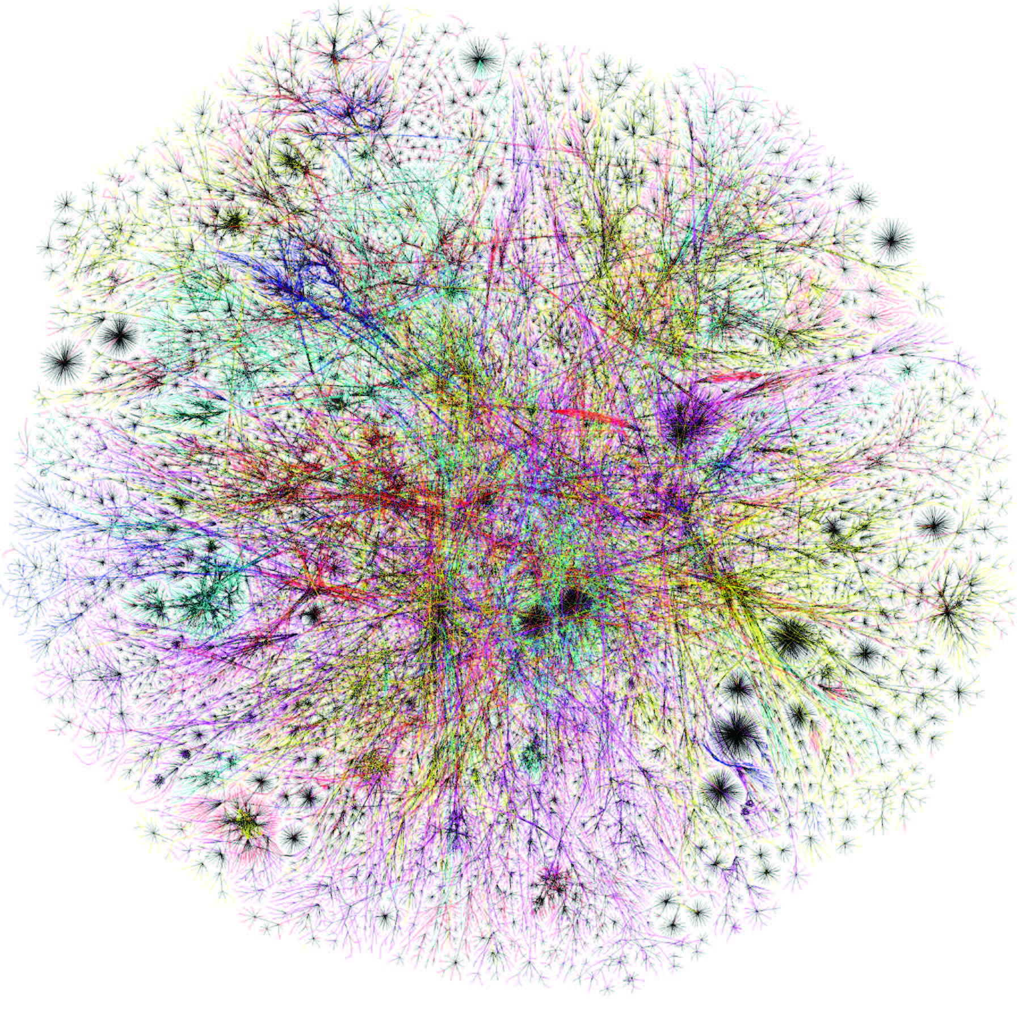
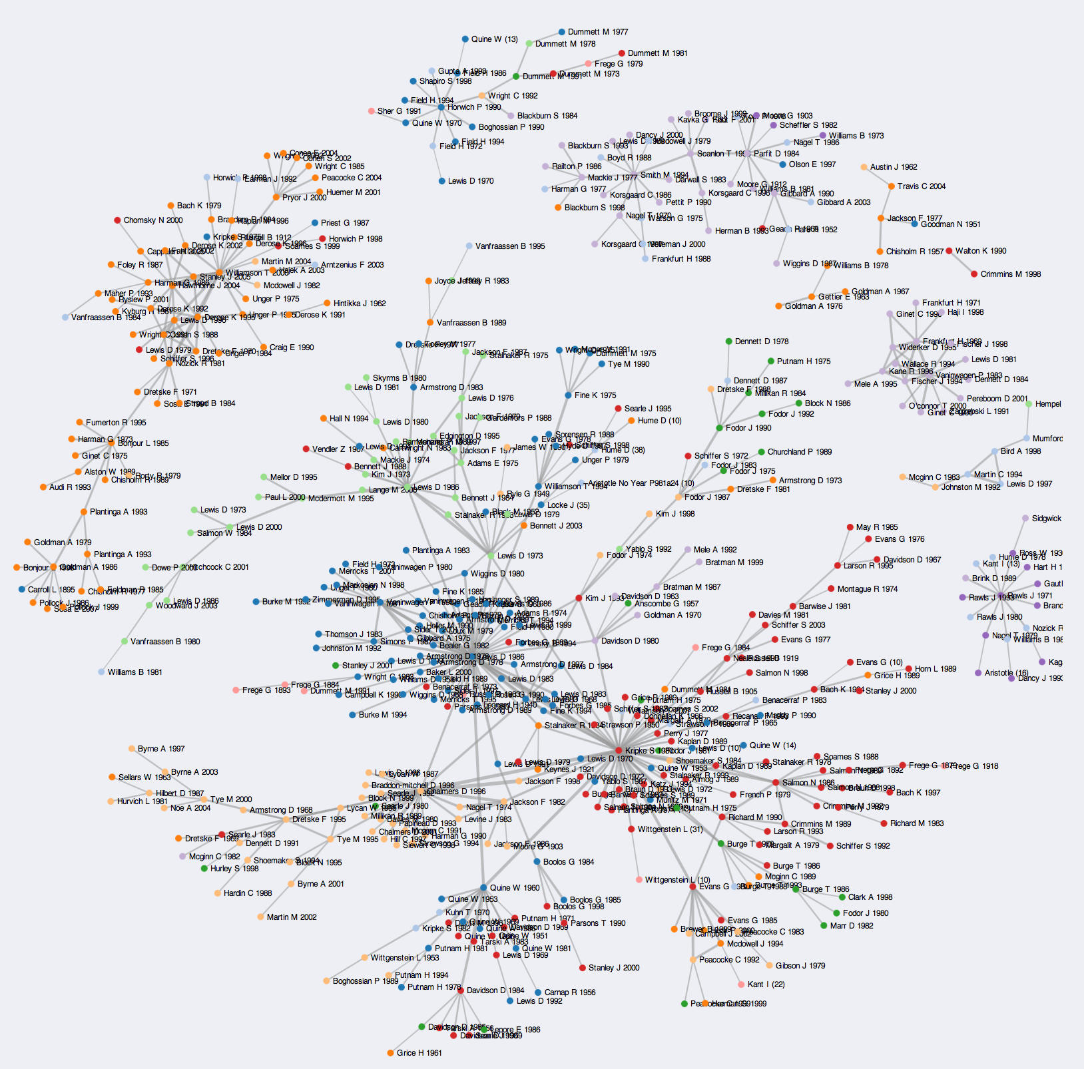
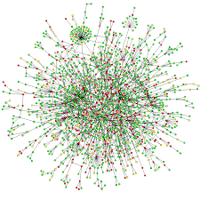
Rough Classification
Technological
networks
Social
networks
Networks of information
Biological networks
Notes:
Technological networks: the Internet at the level of class C subnets (Fig. 1.1 in Newman’s book).
Networks of information: a citation network.
Social networks: romantic links between high-school students during six months preceding the interview (Fig 10.14 in Barabási’s book).
Biological networks: a network of interactions between proteins in a single-celled organism (baker’s yeast).

Slide 4
Technological Networks

Slide 5
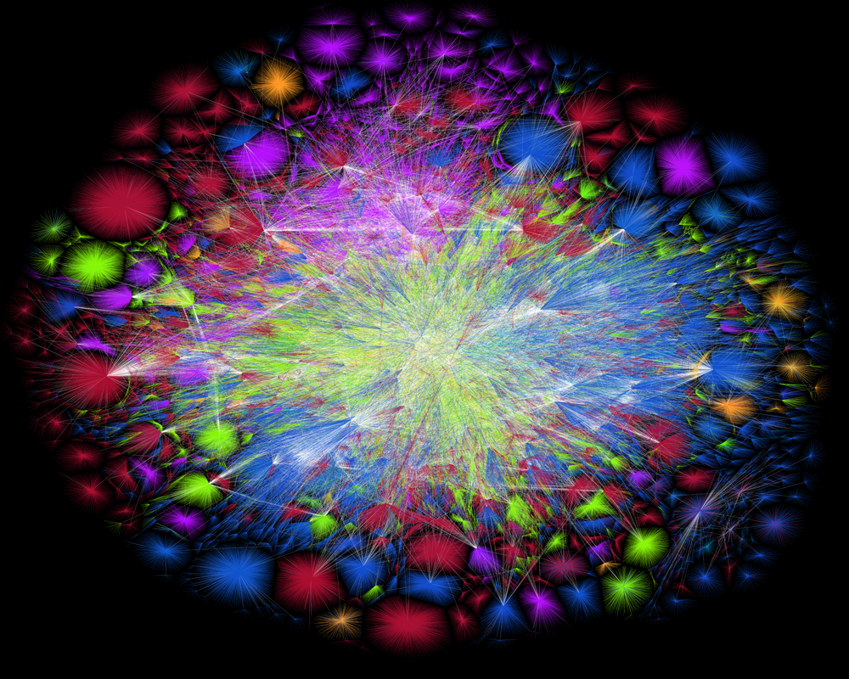
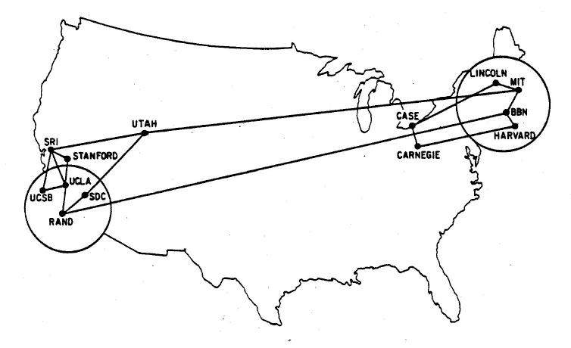
Our First Example: The Internet
ARPANET in 1970: the first packet-switching network, the progenitor of the Internet.
The network structure of the Internet in 2015.

Slide 6
The Internet
What is the Internet? The Internet is the network of physical data connections between computers, phones, tablets, and other devices. Messages sent over the Internet are broken up into packets (small chunks of data) that are sent separately and then reassembled.
Curious fact. Although the Internet is a man-made engineered network, we don’t know exactly what its structure is because it was built by many different groups of people with little centralized control. Our best current data on its structure are derived from experimental measurements.

Slide 7
Telephone Networks
Individual telephones are connected to local exchanges, which are connected in turn to long-distance offices.
The long distance offices are connected among them selves by trunk lines. (There may be connections between local exchanges as well.)

Slide 8
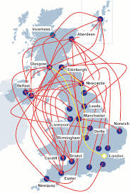
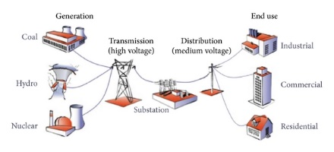
More Examples of Technological Networks
Power grids, water lines, gas pipelines, transportation networks (network of roads, rail lines, airline routes), …

Slide 9
Networks of Information

Slide 10
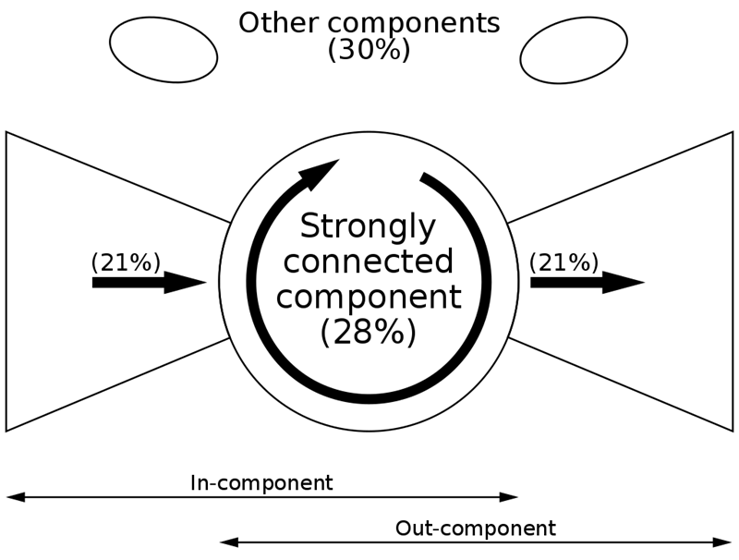
Networks of Information
The Web is a directed network where the nodes are web pages and the directed edges are hyperlinks.
What is the size of the Web?
What is the structure of the Web?
How to search on the Web? How to identify “more important” web pages?
The bow-tie structure of the Web graph.

Slide 11
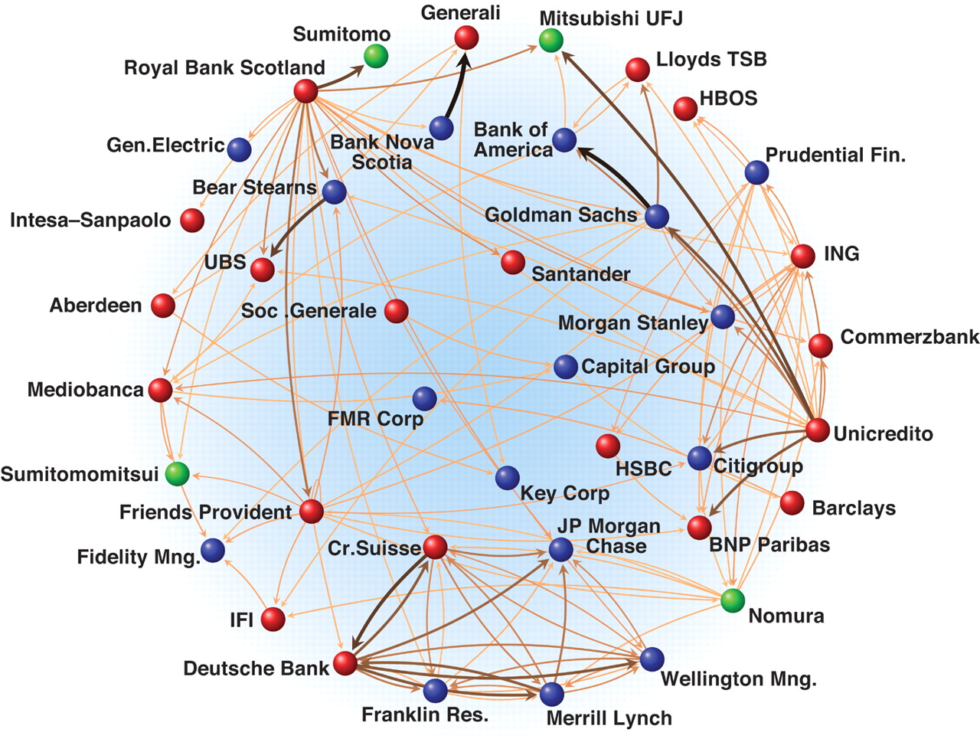
Economic and Financial Networks
Financial transactions between banks, buyer-supplier links, …

Slide 12
More Examples of Information Networks
Citation networks. In a citation network, the nodes are academic papers and the directed edges are bibliographic references. A typical example is Google Scholar. Researchers use citation networks to find papers related to a topic of interest. Another application is to compute citation indexes.
Recommender networks. A recommender network is a bipartite network with two types of node:
one representing products or other items;
the other representing the people with edges connecting to the items they buy or like.

Slide 13
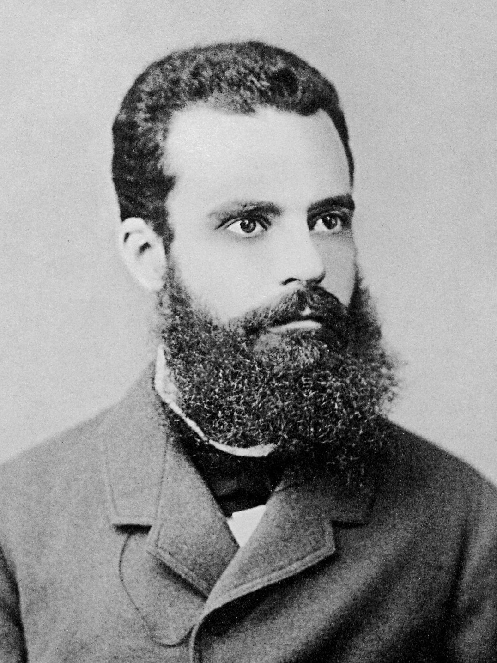

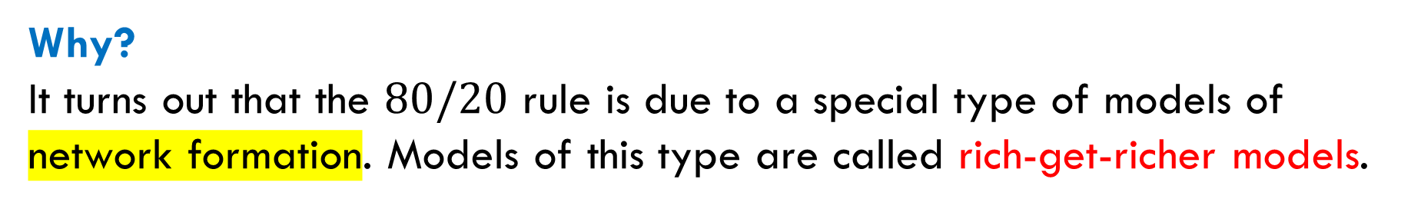
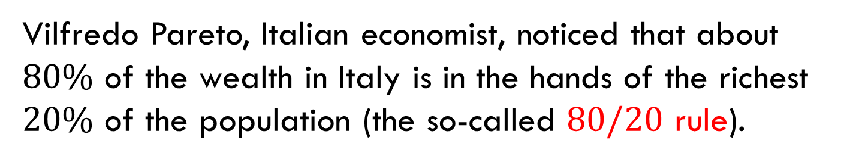
The $80/20$ Rule
Vilfredo Pareto, Italian economist, noticed that about $80\%$ of the wealth in Italy is in the hands of the richest $20\%$ of the population (the so-called $80/20$ rule).
This rule or its close variants occur in many real-world networks, for example, in citation networks (the number of citations is viewed as “wealth”).
Vilfredo Pareto
1848-1923
Why?
It turns out that the $80/20$ rule is due to a special type of models of network formation. Models of this type are called rich-get-richer models.

Slide 14
Social Networks

Slide 15
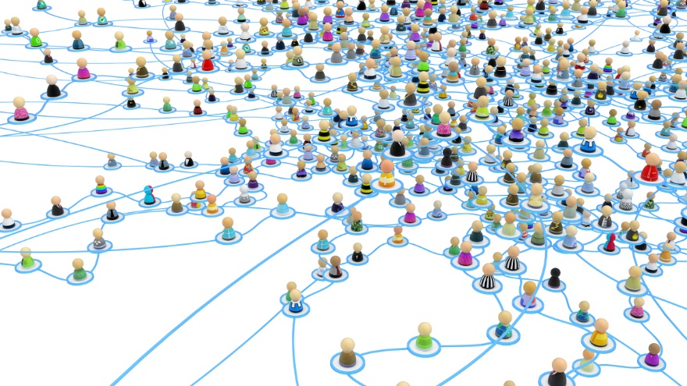
Social Networks
Nodes represent people and edges represent various connections between them, such as friendship ties, message exchange, collaboration, etc.
Well-known examples are online social media like Facebook or Twitter.

Slide 16
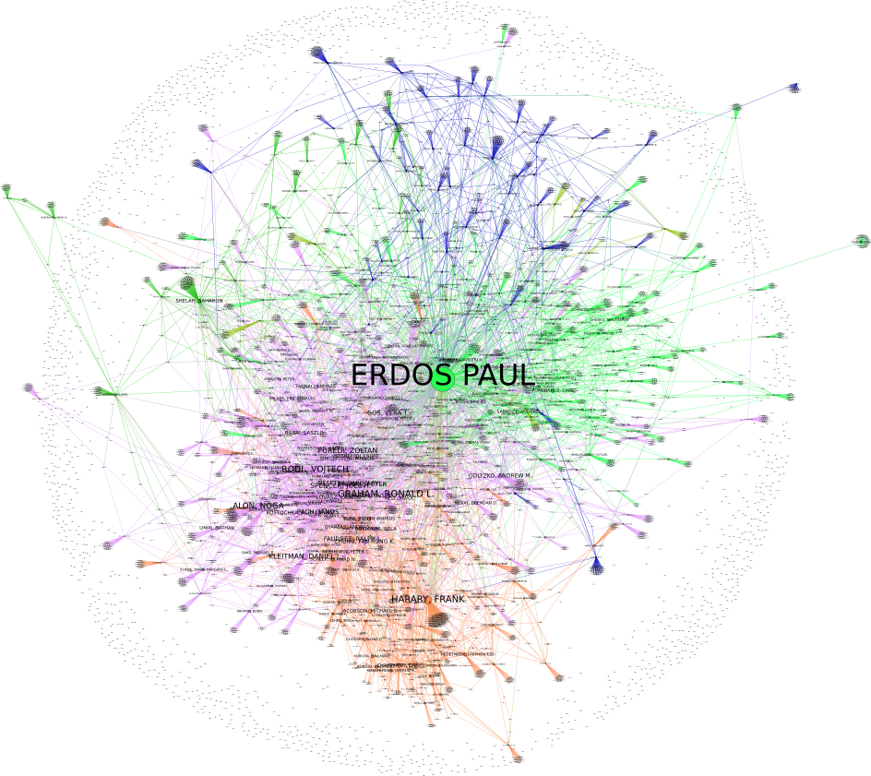
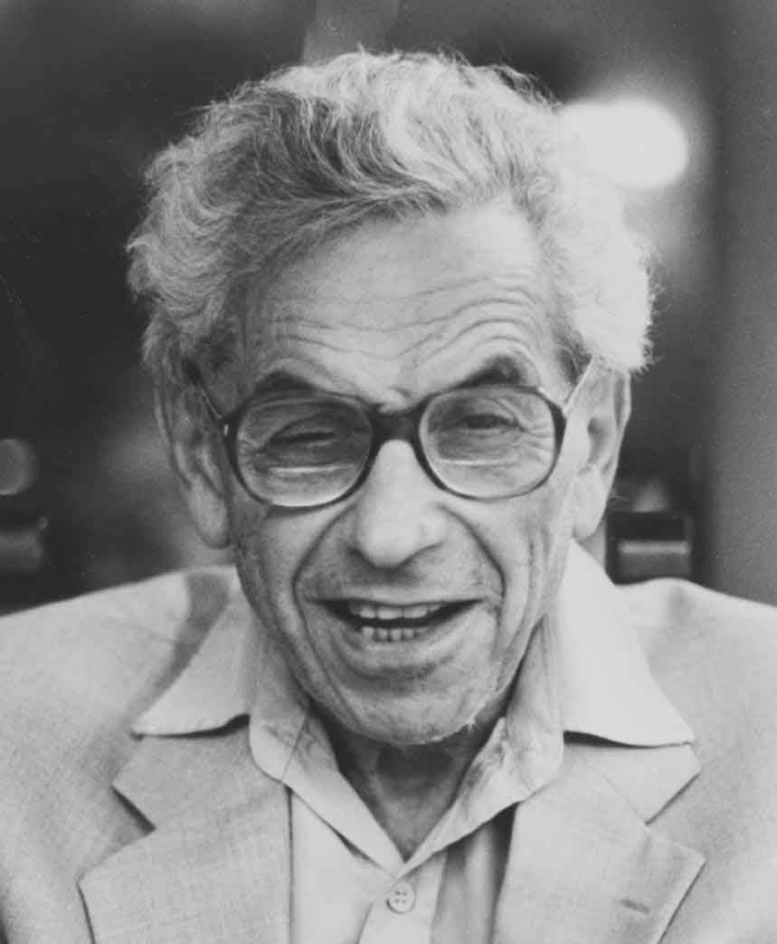



Collaboration Networks: Erdös Number
Collaboration network
Nodes are mathematicians; two nodes are connected by an edge if they co-authored a paper indexed by MathSciNet.
Erdös number
The Erdös number of a node is its collaboration distance from Paul Erdös.
Example:
Paul Erdös
Noga Alon
Ravi Kannan
Evgeny Dantsin

Slide 17
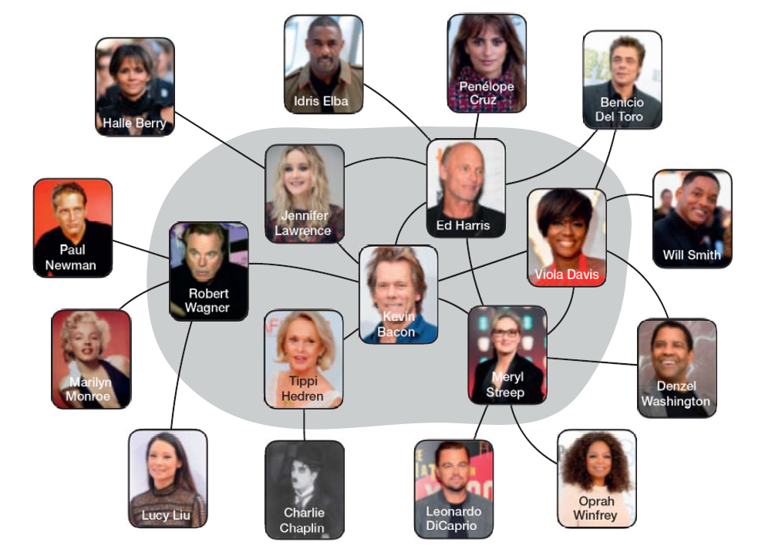
Collaboration Networks: Bacon Number
Co-stardom network
Nodes are movie stars; two nodes are connected by an edge if they co-starred (performed) in the same movie.
Data collection
IMDB, Wikipedia.
Bacon number
The Bacon number of a node is its collaboration distance from Kevin Bacon.
Bacon number online calculator: https://oracleofbacon.org/

Slide 18
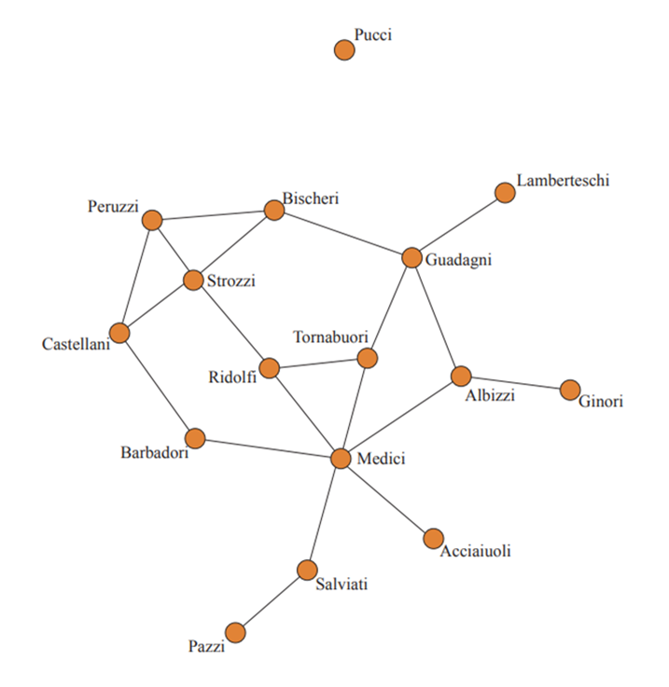
Historical Small-Scale Example
Intermarriage network of the ruling families of the Republic of Florence in the 15th century. The nodes represent Florentine families and the edges represent ties of marriage between them.
The Medici family used centrality in the network to become the most powerful family in Florence.

Slide 19
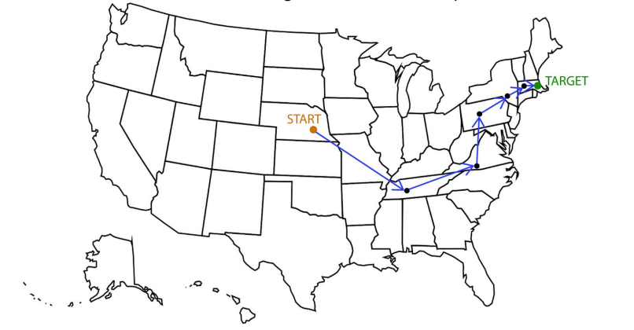
Small-World Experiments
Research in social psychology. Experiments showed that there exist short paths between people in social networks (the average length is about 6). Another, perhaps more surprising result, is that people found these paths.
The first experiment was made by Stanley Milgram in the 1960s.

Slide 20
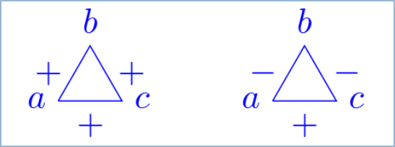

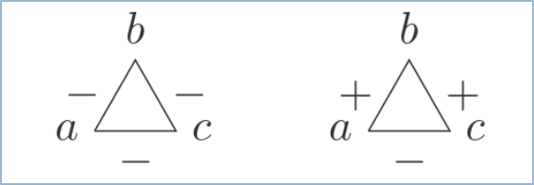

Positive and Negative Relationships
Research in social psychology. Study of social networks where edges are either positive (friends) or negative (enemies). It turned out that all triangles in such networks are either stable or unstable:
Harari’s theorem. The nodes are divided into two groups such that all edges inside each group are positive and all edges between the groups are negative.

Slide 21
Strong and Weak Ties
Research in sociology. In the 1970s, Mark Granovetter studied how people learned information leading to their current job.
Main result. When people got this information through personal contacts, it came from distant acquaintances much more often than from close friends.
Strength of weak ties. Valuable information comes from different communities. The study showed that “weak ties” form “bridges” across communities and thus play critical roles in the dissemination of information.

Slide 22
Biological Networks

Slide 23
Biochemical Networks
Molecular-level patterns of interaction and control in the biological cell:
metabolic networks;
protein-protein interaction networks;
genetic regulatory networks, etc.
A network of interactions between proteins in a single-celled organism (baker’s yeast).

Slide 24
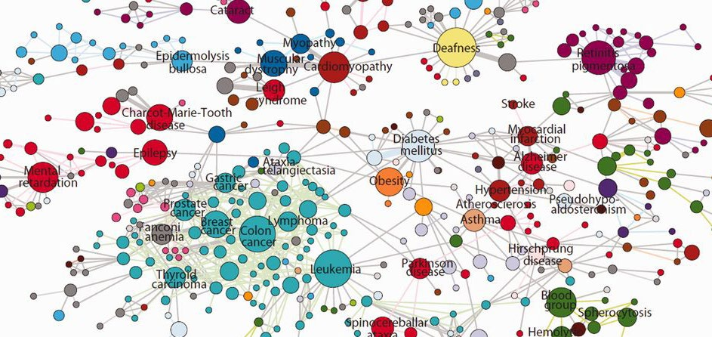
Medical Networks
The nodes are human diseases connected if they have common genetic origin.

Slide 25
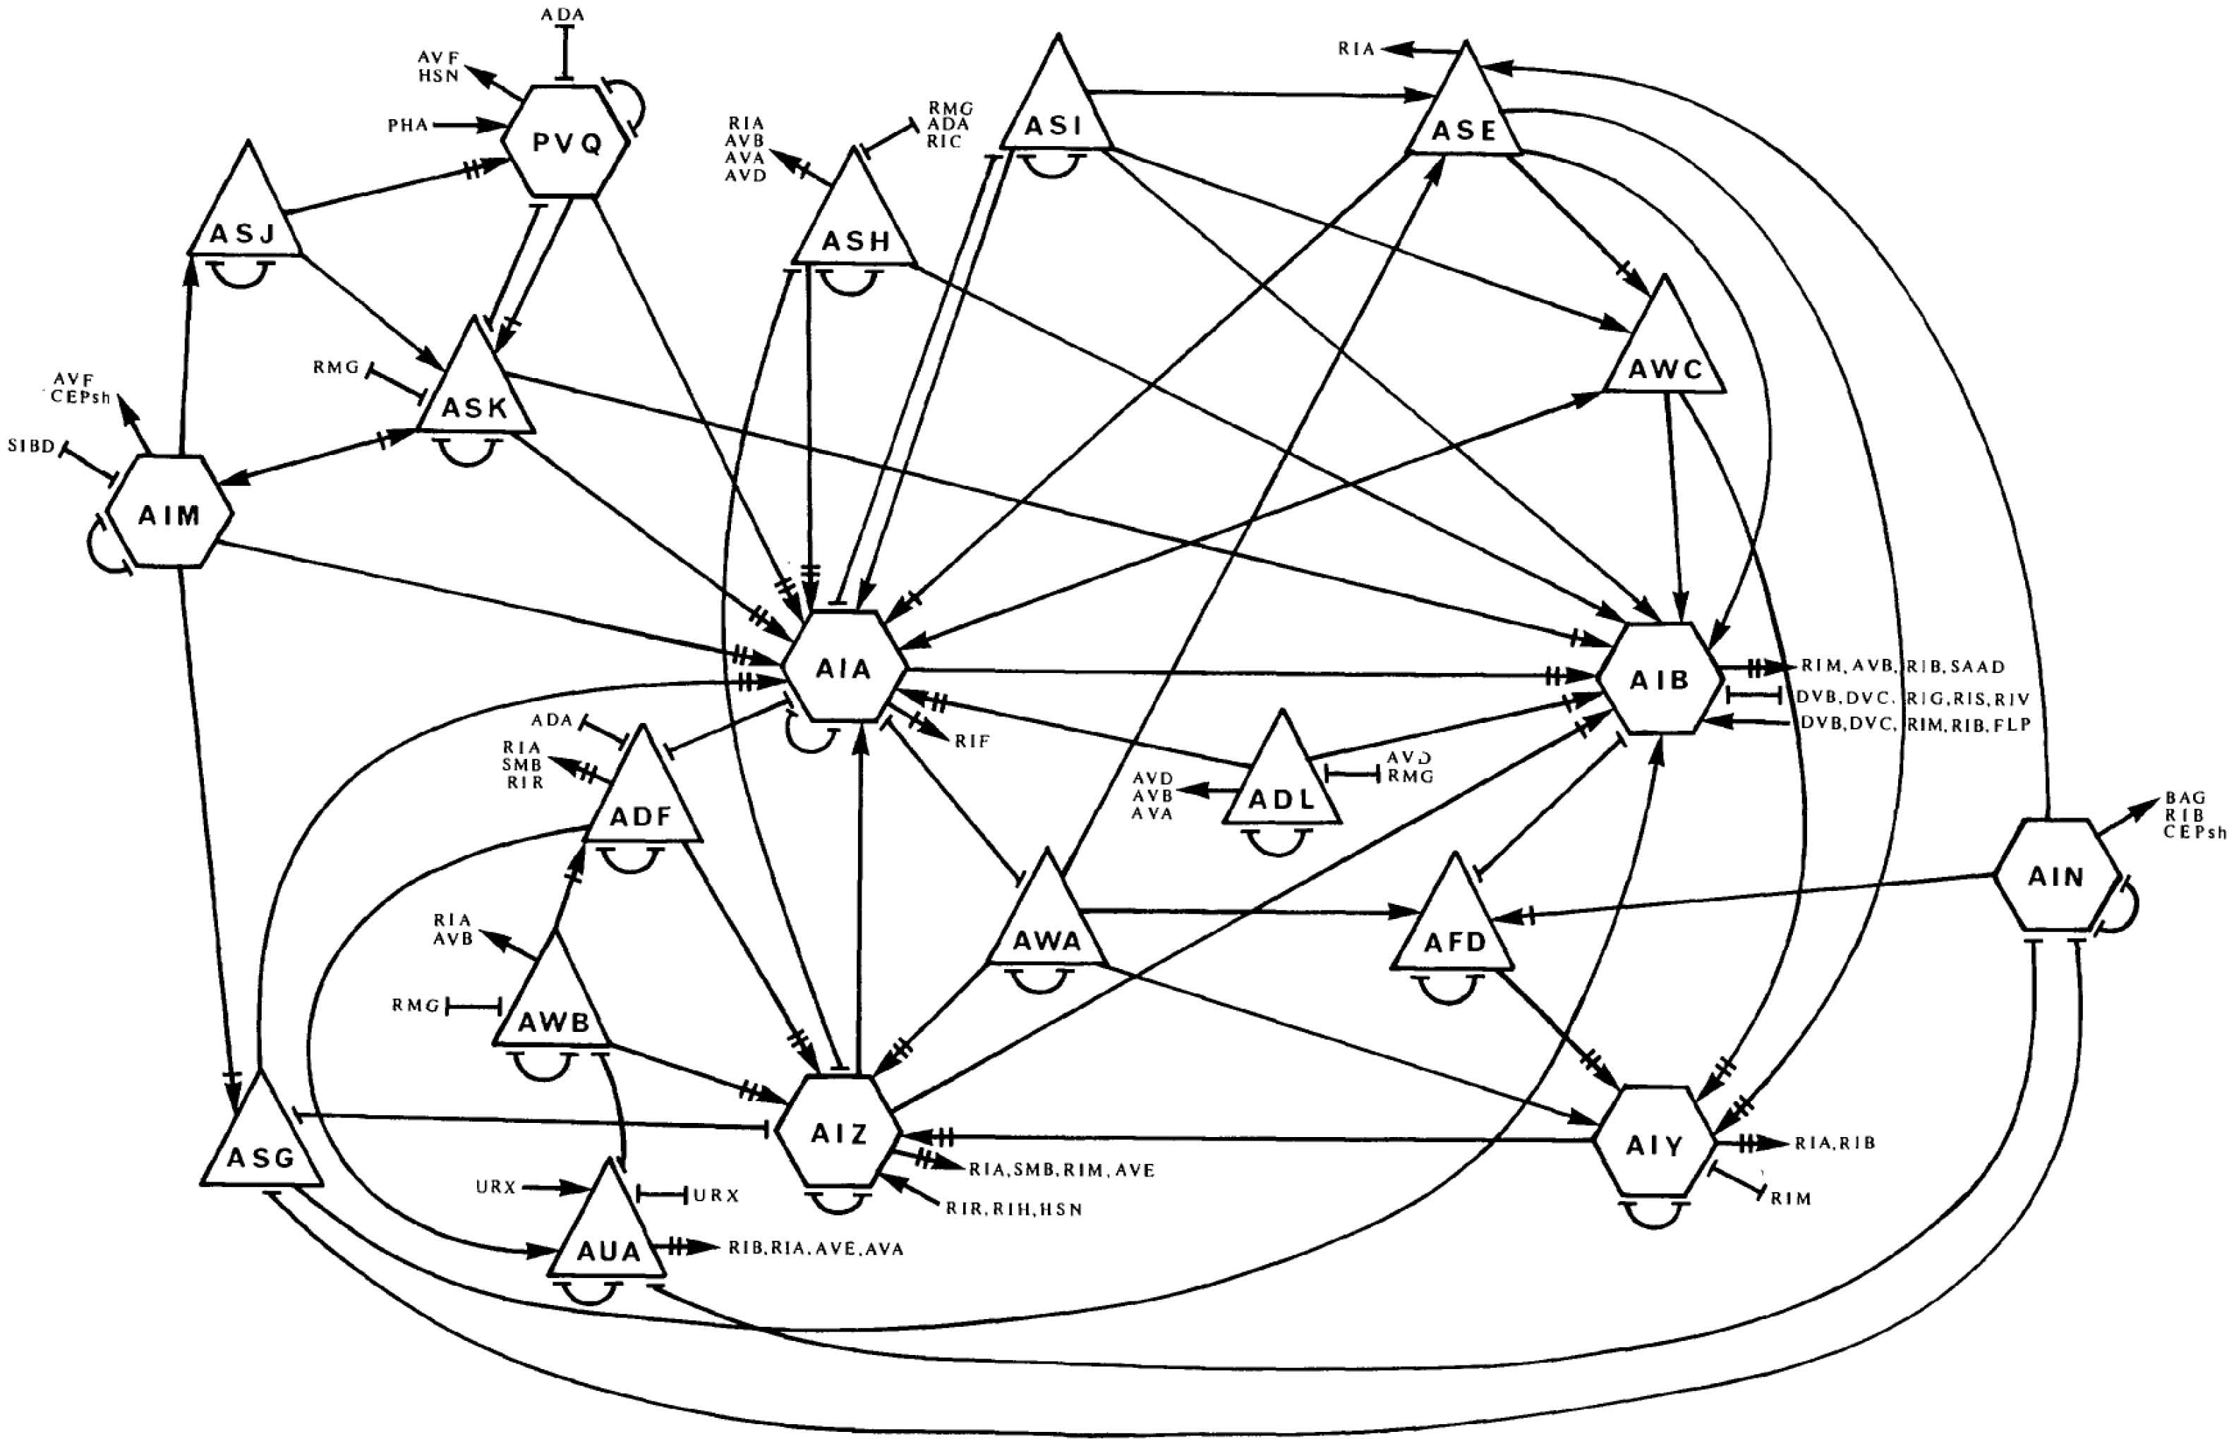
Networks in the Brain
Networks of neurons and networks of functional connectivity in the brain.
A part of the brain circuitry of a worm.

Slide 26
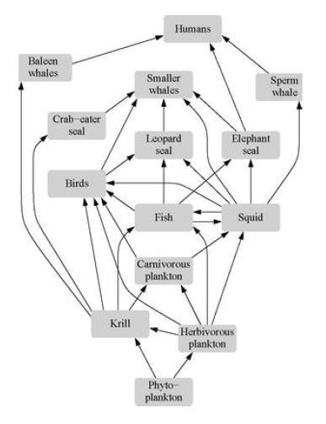
Ecological Networks
Networks of ecological interaction between species, such as food webs or host-parasite networks.
A food web of species in Antarctica.

Slide 27
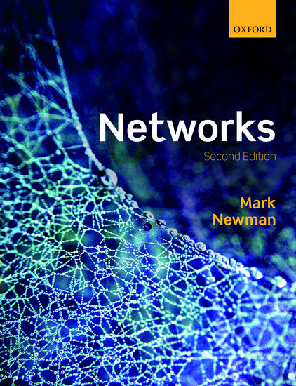
Reading
Chapter 1

